Slide 1
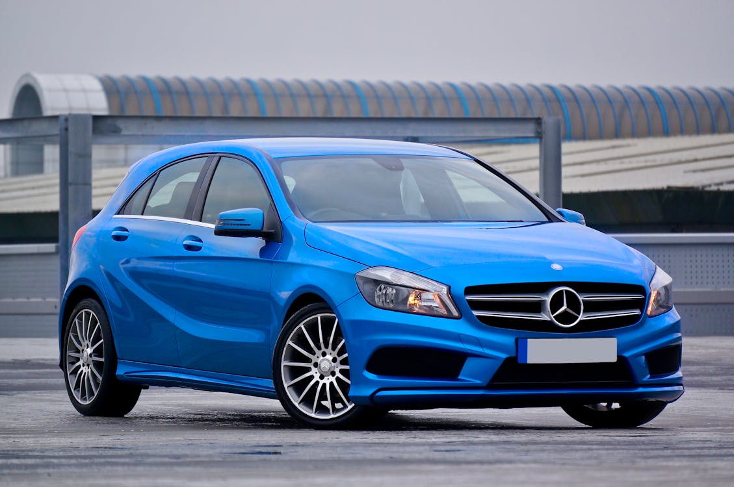
Trends in vehicle Licensing by fuel type in the Britain
To analyse how licensed electric, hybrid, diesel and petrol cars have changed in the last 10 years
Daniel Austin

Slide 2
Dataset
df_VEH0120 data from the department for transport and the DVLA https://www.gov.uk/government/statistical-data-sets/vehicle-licensing-statistics-data-files
The dataset contains records for every vehicle model licenced and SORN in the uk.
Contains fields for fuel type (petrol, diesel, electric and hybrid), body type (cars, motorbikes, vans ect) and number of licenced vehicles in each quarter from 1994Q4 to 2024Q2

Slide 3
Transformation and analysis
Data transformation and analysis was complete using python with the pandas library.
The dataset was obtained pre-cleaned and contained no null values
The data was filtered for licensed vehicles only as not to contain SORN Vehicles
A pivot table for each visual was generated. This gave a quarters as columns, which was transposed quarters as rows for plotting
Matplotlib was used for plotting visuals

Slide 4
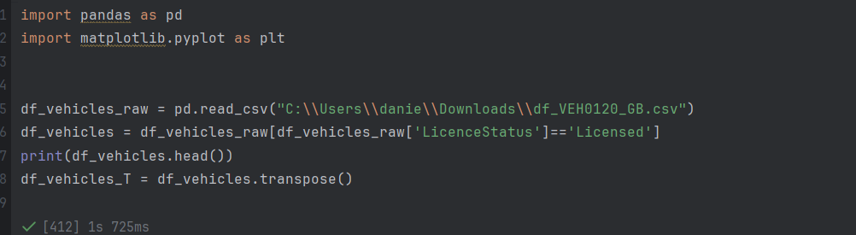
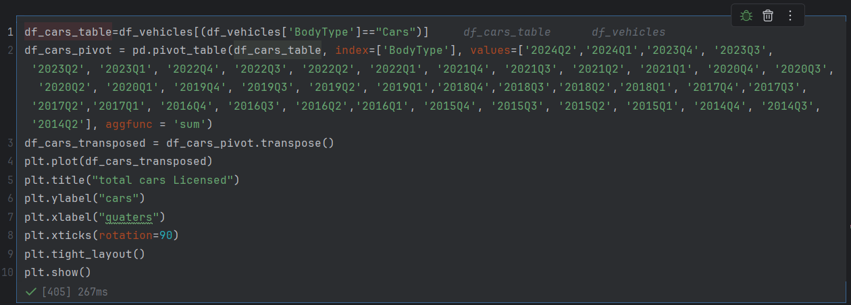
Code

Slide 5
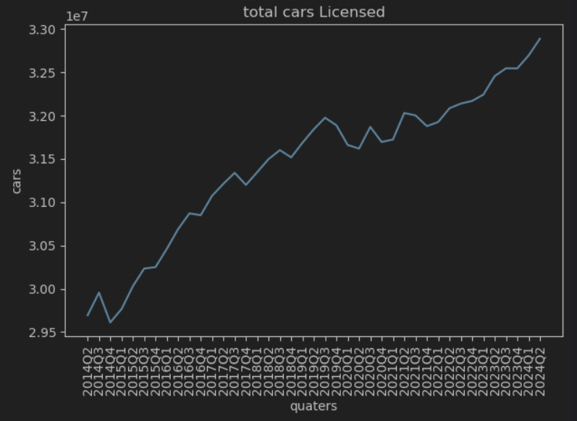
Total cars licensed

Slide 6
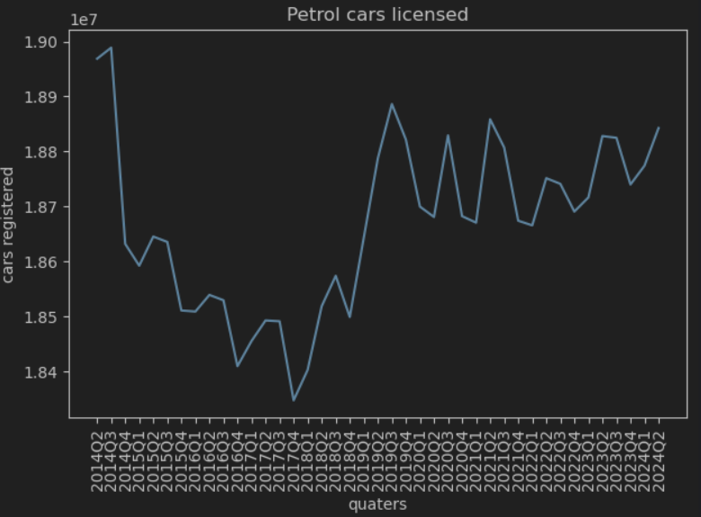
Petrol cars

Slide 7
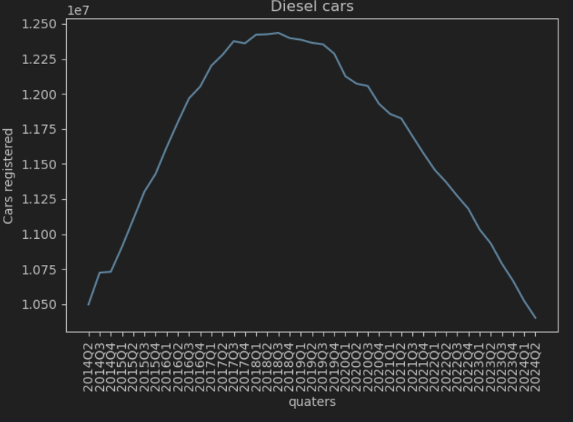
Diesel Cars

Slide 8
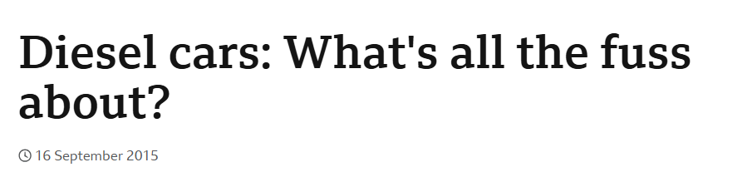
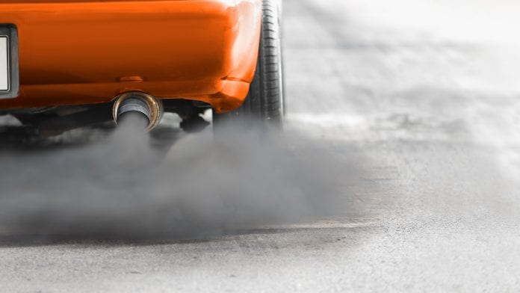
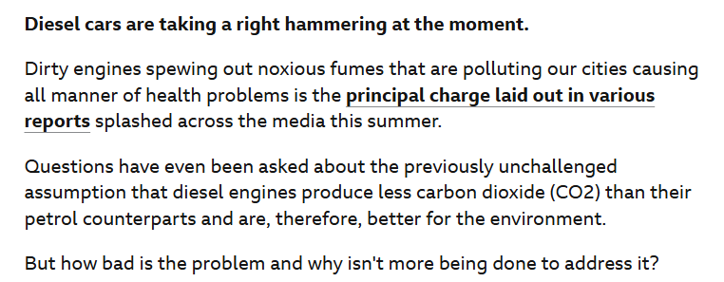
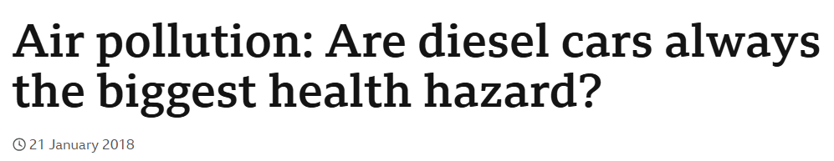
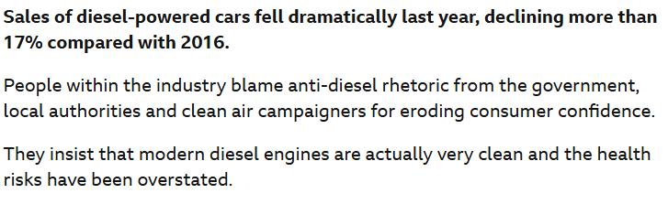
What’s going on with diesel?
https://www.bbc.co.uk/news/business-34257424
https://www.bbc.co.uk/news/science-environment-42666596

Slide 9
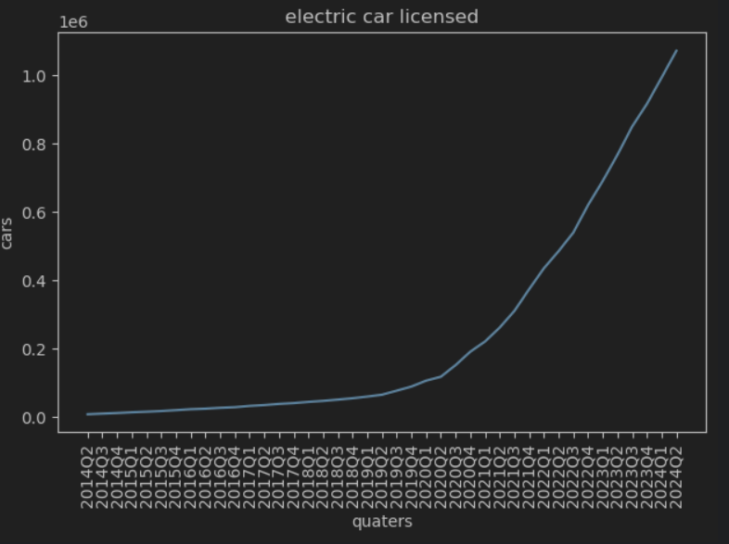
Electric cars

Slide 10
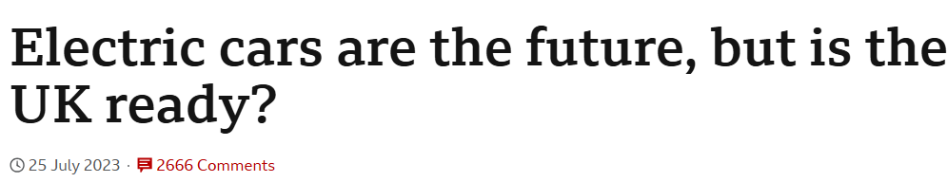
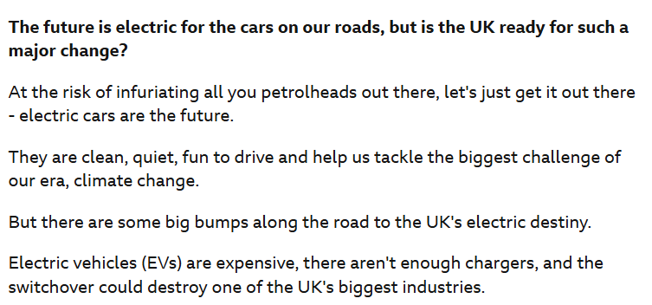
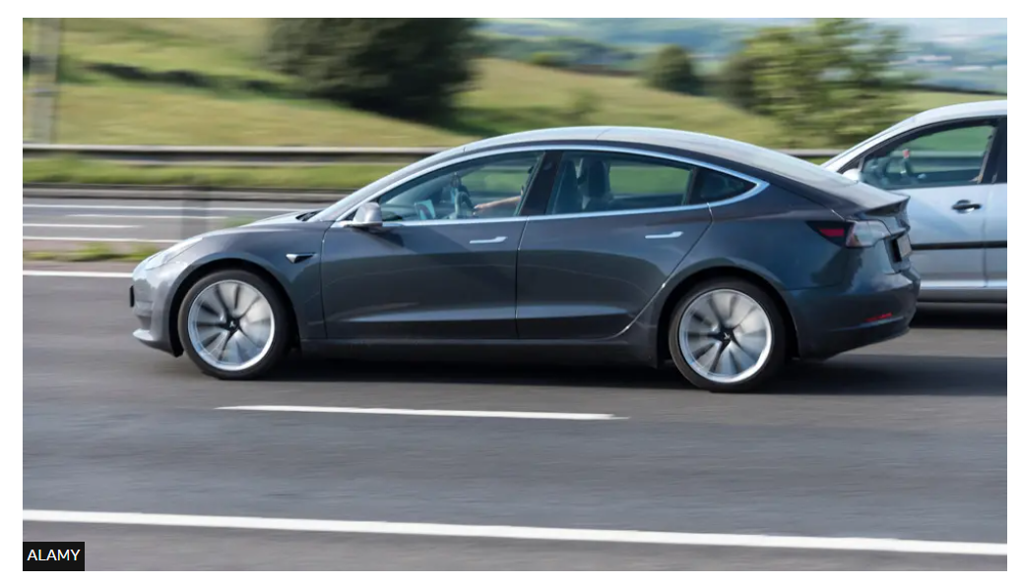
The future electric?
https://www.bbc.co.uk/news/science-environment-66222554

Slide 11
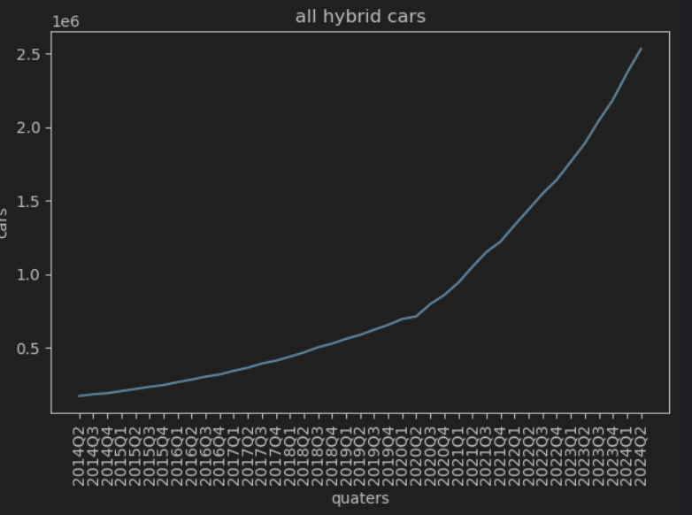
Hybrid Cars

Slide 12
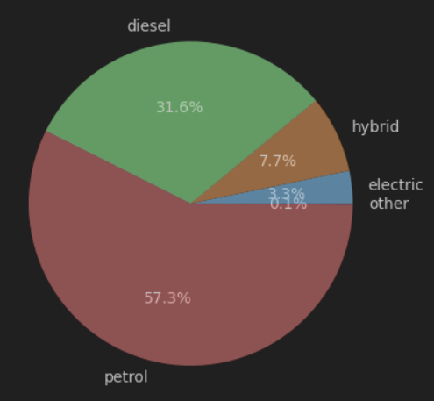
Fuels in 2024Q2

Slide 13
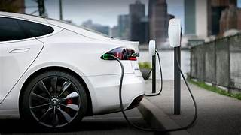
Conclusion
The number of cars on the road continues to grow
There is a move away from more polluting fuels such as diesel and towards electric and hybrid cars.
To support to growth in electric cars more infrastructure such as charging facilities should be provided

